Slide 1
Australia vs Singapore
Statistics
Group 1
Member: Syed
Pouria
Kay
Joe
Elena

Slide 2
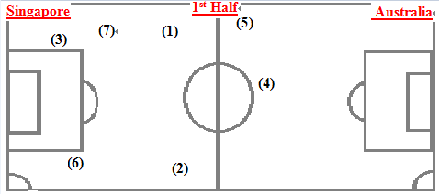
Free-kick (1st half)
Australia |  | Singapore
Left Pitch | Right Pitch | Left Pitch | Right Pitch
No.15 18:45 (2) | No.2 06:17 (1) | No.23 31:23 (4)
No.8 +0.29 (6) | No.19 21:23 (3) | No. 23 40:08 (5)
 | No.19 +2:26 (7)

Slide 3
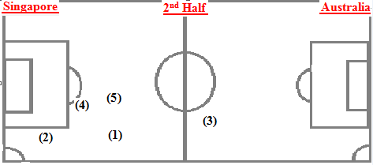
Free-kick (2nd half)
Australia |  | Singapore
Left Pitch | Right Pitch | Left Pitch | Right Pitch
No:8 57:20 (1) |  |  | No.3 85:59 (3)
No.6 58:30 (2)
No.9 89:48 (4)
No.4 +2:48 (5)

Slide 4
Corner kick
Singapore
First half |  | Second half |  | Total
Right | Left | Right | Left
0 | 0 | 0 | 0 | 0
Australia
First half |  | Second half |  | Total
Right | Left | Right | Left
7 | 1 | 3 | 1 | 12

Slide 5
Shooting
Australia
Shot on:
First Half |  |  | Second half |  |  | Total
Left | Centre | Right | Left | Centre | Right
0 | 0 | 4 | 0 | 0 | 2 | 6
Shot out:
First Half |  |  | Second half |  |  | Total
Left | Centre | Right | Left | Centre | Right
2 | 0 | 2 | 0 | 5 | 1 | 10

Slide 6
Shooting
Singapore
Shot on:
First Half |  |  | Second half |  |  | Total
Left | Centre | Right | Left | Centre | Right
0 | 0 | 0 | 0 | 0 | 0 | 0
Shot out:
First Half |  |  | Second half |  |  | Total
Left | Centre | Right | Left | Centre | Right
0 | 0 | 0 | 1 | 0 | 0 | 1

Slide 7
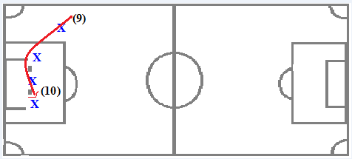
Scoring
Australia 1:0 Singapore
51’ No:19 Recee Caira
Adam Taggart (No:9) crosses the ball from right side , and then Recee Caira(No:19) scored a goal by heading .

Slide 8
Substitution
Australia |  |  | Singapore
Minute | In | Out | Minute | In | Out
83’ | Retre(38) | Barker(8) | 45’ | Seyd Hamid(25) | Aabudin(15)
 |  |  | 55’ | Shanoon(16) | Henzry(26)
 |  |  | 81’ | Gerard(2) | Razali(10)

Slide 9
General Impression☺

