Slide 1
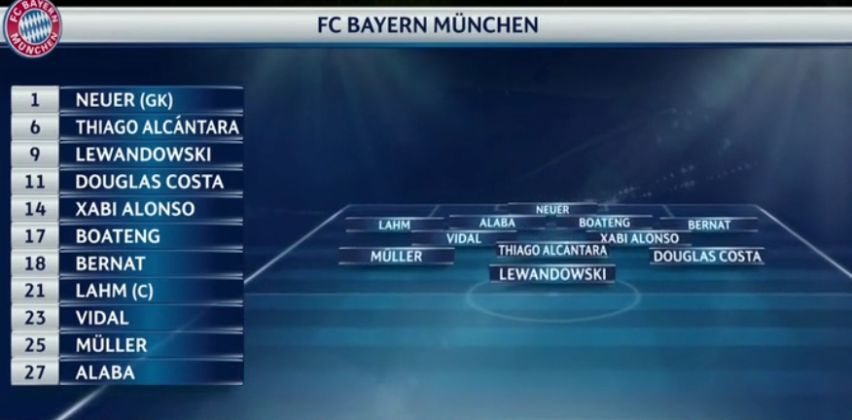
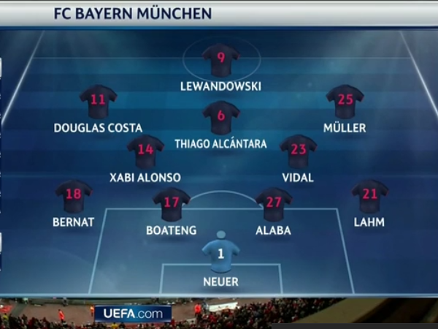
Playing the 4.2.3.1

Slide 2
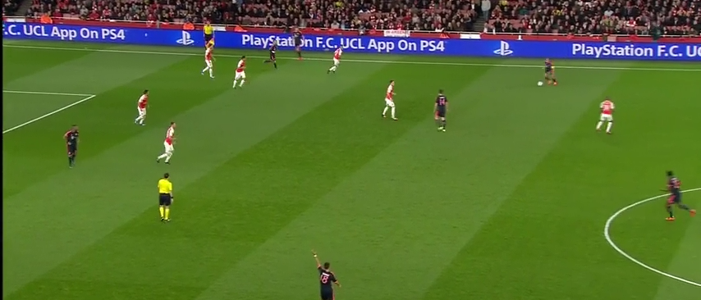
Is a most popular formation
Out-number in midfield
Flexible to support defense &offense quickly and effectively
Players roles are clearly defined
Overview

Slide 3
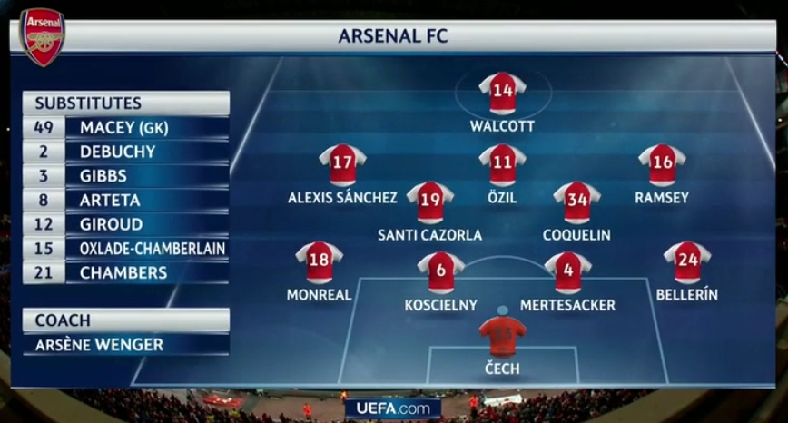

Slide 4
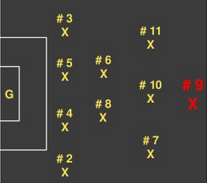
#9 - Central striker
Responsibilities:
Offense
Score goals
Hold the ball with back to goal
Play 1&2 with supporting players
Make runs for through balls
Defense
Pressure defenders with the ball
Force defenders to play to one side of the field

Slide 5
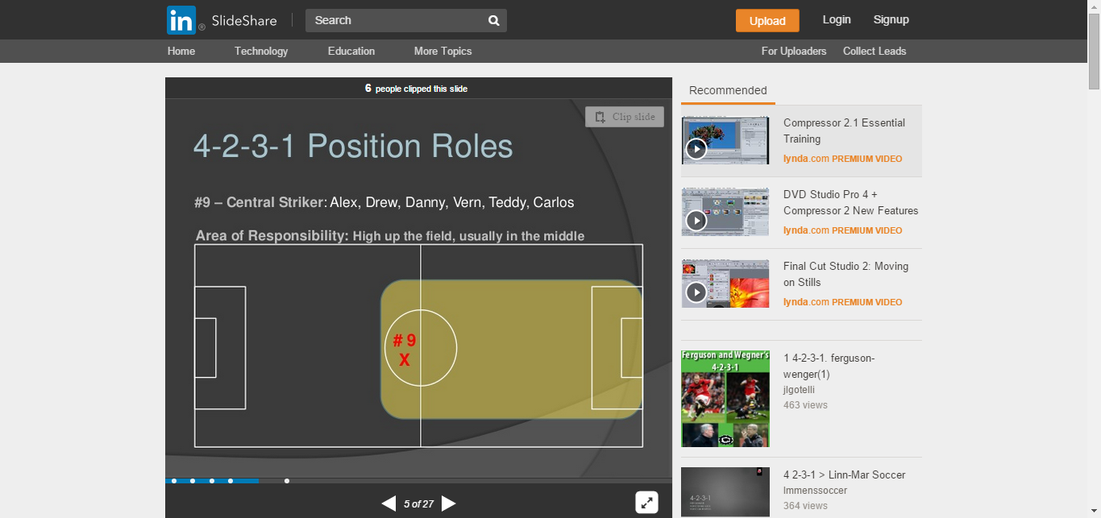
#9 – central striker
Area of responsibility:
High up the field, usually in the middle

Slide 6
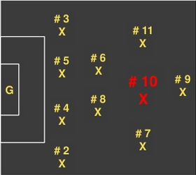
# 10 center attacking mid
responsibilities:
Offense
Set up goals with passing
Play the ball out to #11 and #7
Play through balls for #9 #11 and #7
Use #6 and #8 to maintain possession
Defense
Pressure defensive midfielder when he has the ball
Drop to middle force ball out wide

Slide 7
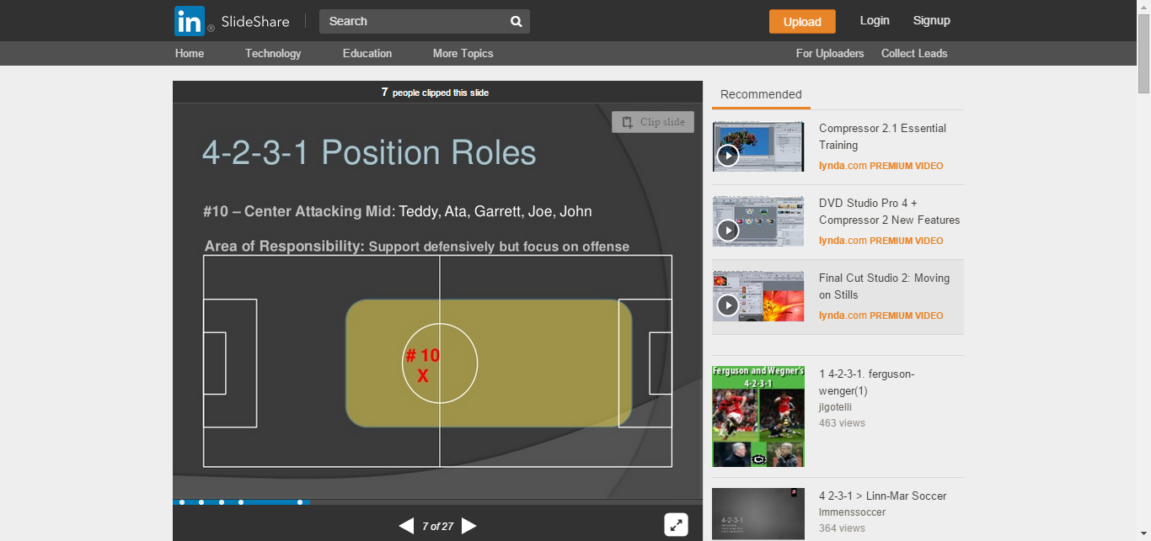
#10 – center
attacking mid
area of responsibilities:
Support defensively
but focus on offense

Slide 8
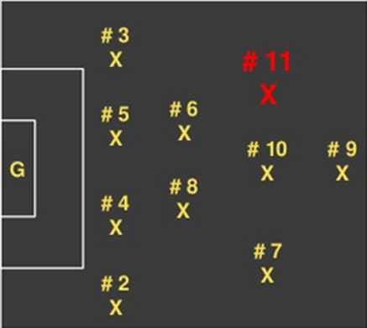
#11 – left attacking mid
Responsibilities:
Offense
Stay in middle and get into attack when ball moves forward
Play the ball out wide to overlapping #3
Play 1,2 with #9 and #10
Play through balls for #9 and #10
Cut in on right foot to take shots at goal
Defense
Pressure outside defensive back when he has the ball
Force the ball wide towards the sideline
Covers defensively for #3 when he goes forward on overlapping run

Slide 9
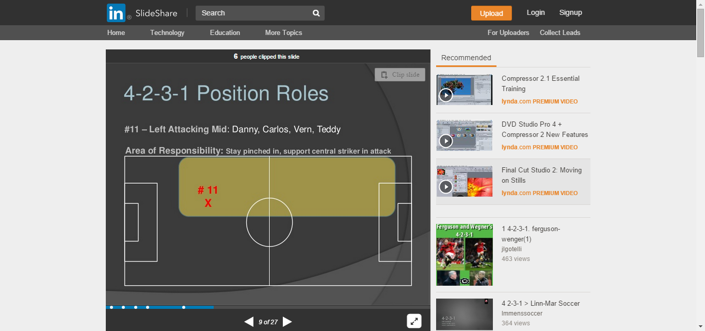
#11 – left attacking mid
Area of responsibilities:
Stay closer, support
central striker in attack

Slide 10
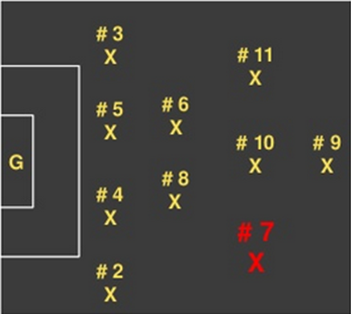
#7 – right attacking mid
Responsibilities:
Offense
Stay closer to the middle and get into attack when ball moves forward
Play the ball out wide to overlapping #2
play 1&2 with #9 and #10
Play through balls for #9 and #10
Cut in on left foot to take shots on goal
Defense
Pressure outside defensive back when he has the ball
Force the ball wide towards the sideline
Covers defensively for #2 when he goes forward on overlapping run

Slide 11
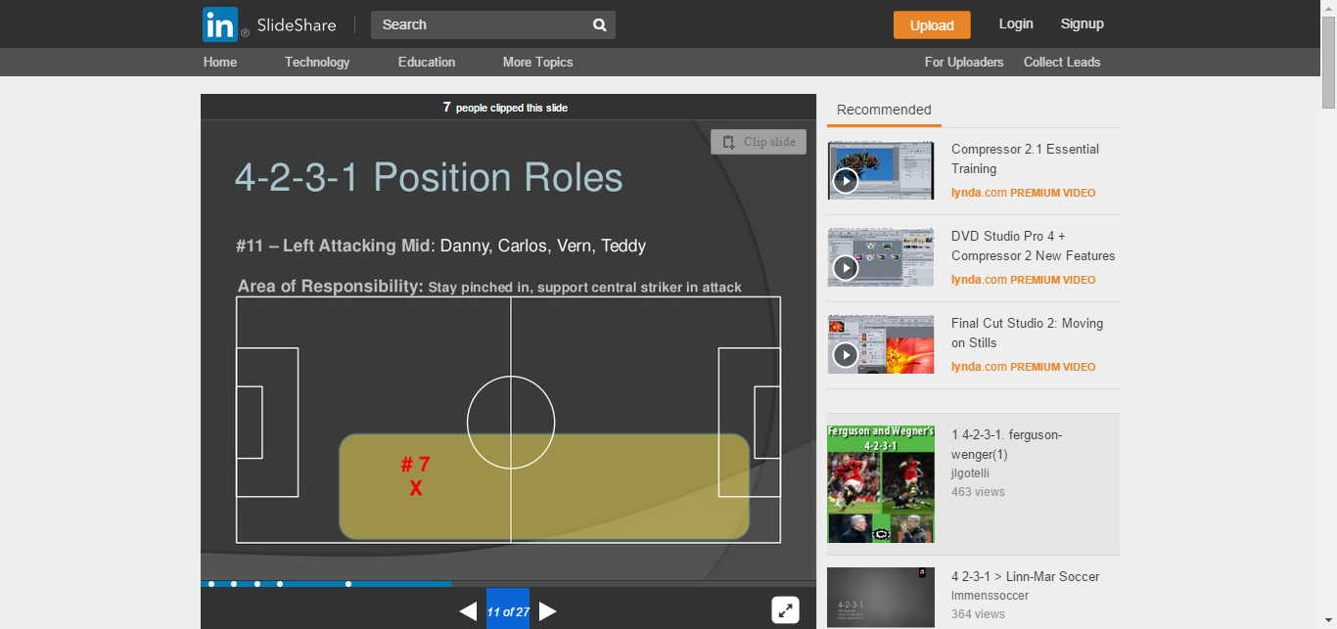
#7 – left
attacking mid
Area of responsibilities:
Stay closer, support central striker in attack

Slide 12
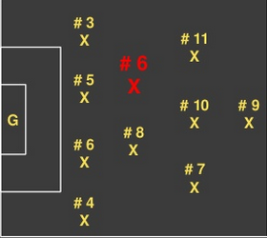
#6 – defensive mid
Responsibilities:
Offensive
Play the ball wide to #3on overlaps
Play 1&2 with #11 and #10
Play balls over the top to #9
Defense
Cut off passing lanes from opposition midfield to forward
Close down space on opposition offensive midfielders
Stays in front of defense to support
Drops into middle between #5 and #4 when they spread wide to play the ball out of the back

Slide 13
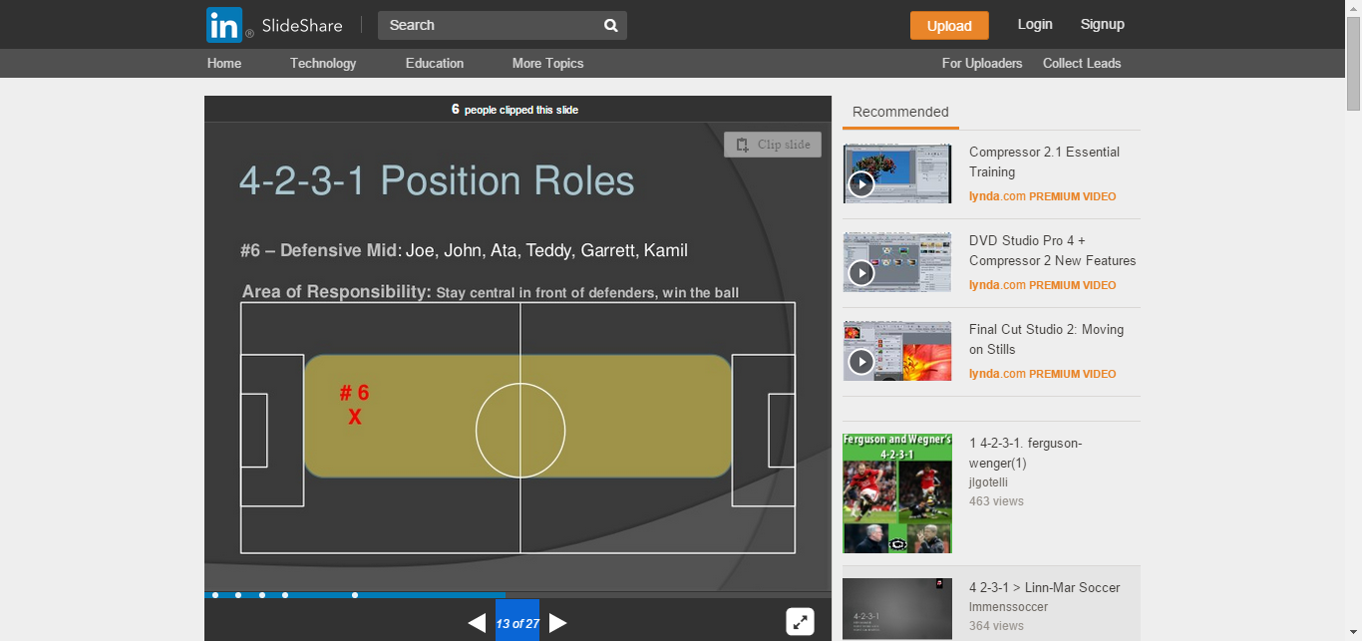
#6 – defensive mid
Area of responsibilities:
Stay central in front of
defenders, win the ball

Slide 14

#8 – defensive mid
Responsibilities:
Offense
Play the ball wide to #2 on overlaps
Play 1,2 with #7 and #10
Play balls over the top to #9
Defense
Cut off passing lanes from opposition MF to F
Stay in front of defense to support
Drops into middle between #5 and #4 when they spread wide to play the ball out of the back

Slide 15
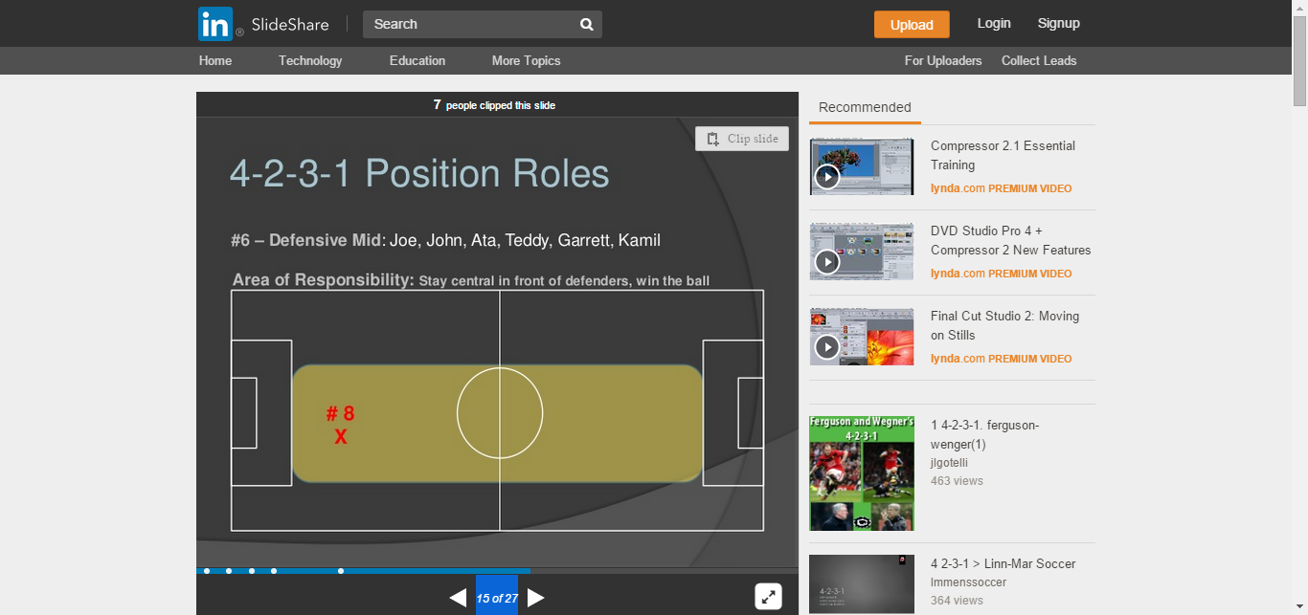
#8 – defensive mid
Area of responsibilities:
Stay central in front of defenders, win the ball

Slide 16
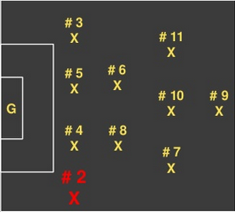
#2 – outside back
Responsibilities:
Offense
Stay wide
Play ball through #8 and #7
Overlap, overlap, overlap
Take ball to end line and cross into #9 or cutback to offensive midfielders
Defense
Mark wingers from other team
Force play wide toward side line and prevent crosses from coming in
Close into #4 when team loses possession

Slide 17
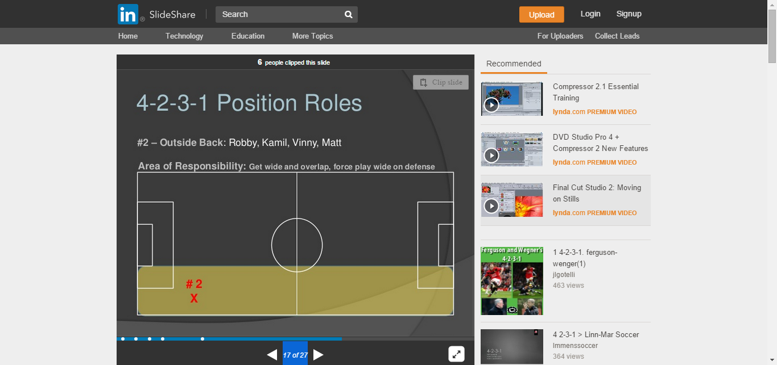
#2 – outside back
Area of responsibilities:
Get wide and overlap,
force play wide on defense

Slide 18
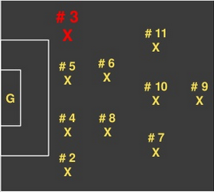
#3 – outside back
Responsibilities:
Offense
Stay wide
Play ball through #6 and #11
Overlap, overlap, overlap
Take ball to end line and cross into #9
or cutback to offensive midfielders
Defense
Mark wingers from other team
Force play wide toward side line
and prevent crosses from coming in
Close into #5 when team loses possession

Slide 19
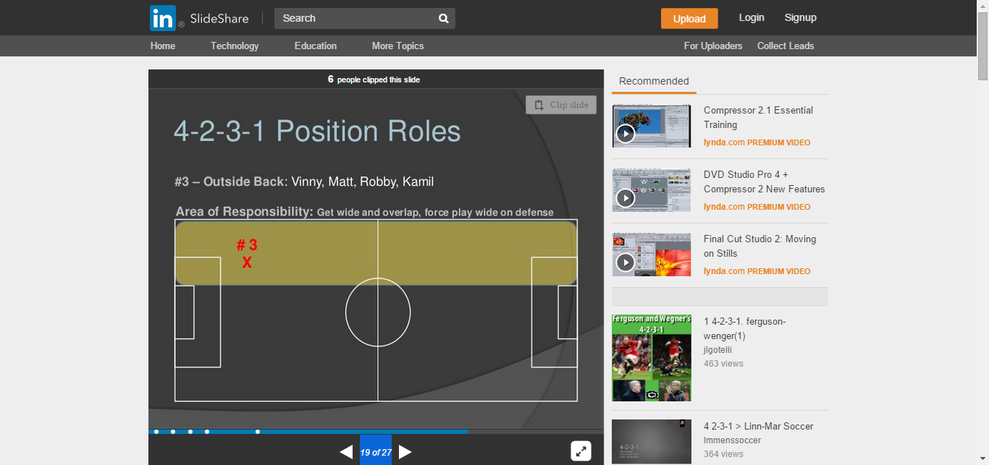
#3 – outside back
Area of responsibilities:
Get wide and overlap, force play wide on defense

Slide 20
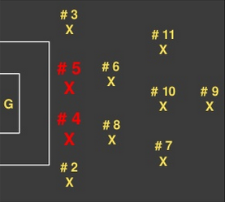
#4 & 5 – central defense
Responsibilities:
Offense
Play the ball wide to #3 and #2
Play ball through #6 #8
Support midfield to maintain possession
Get to corners of the 18 yard box to begin play from the back
Defense
Mark central strikers from other team
Win tackles and headers
Organize defense and make sure team is keeping its shape - compact

Slide 21
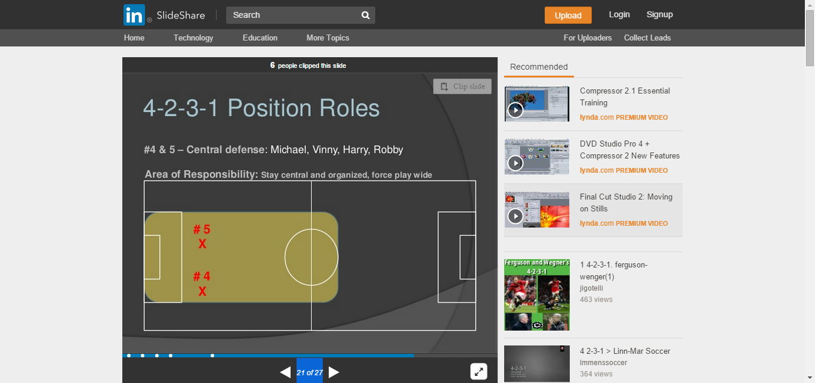
#4 & 5 –
central defense
Area of responsibilities:
Stay central and organized,
force play wide

Slide 22

#G – goalie
Responsibilities:
Offense
Distribution to outside backs
Move to support fullbacks to maintain possession
Defense
Stop shots
Make sure defenders are covering players and staying compact

Slide 23
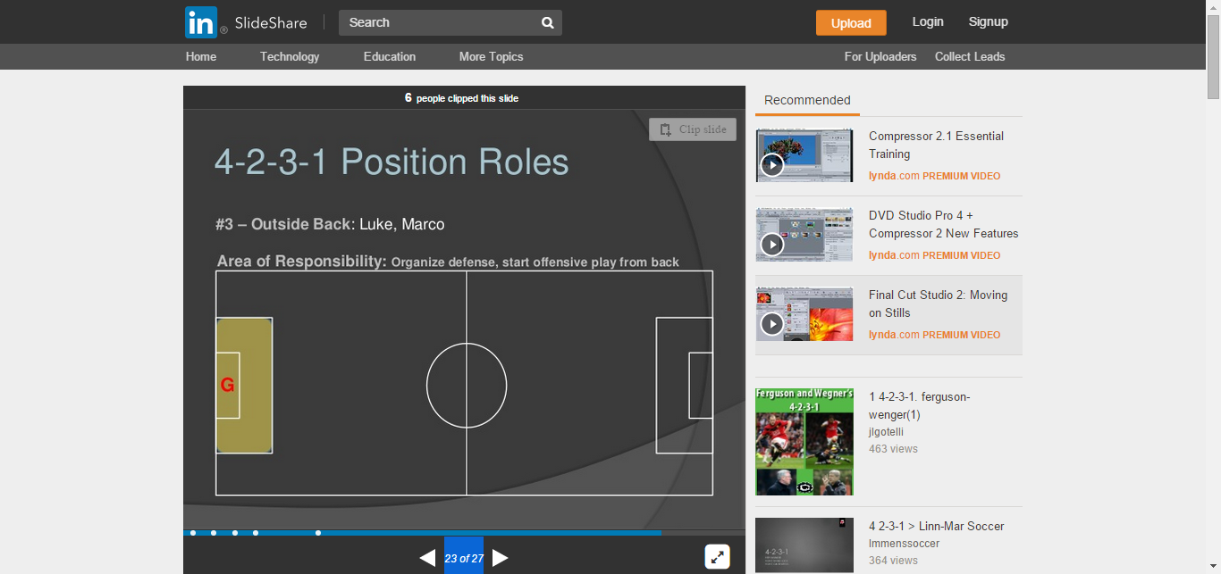
#G – outside back:
organize defense,
start offensive play from back

Slide 24
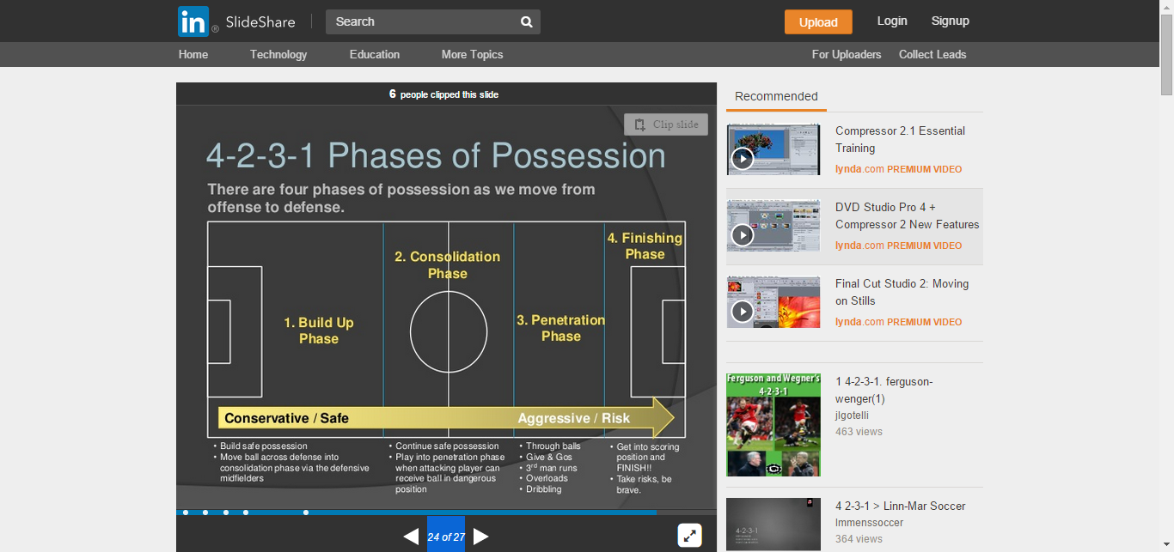
4.2.3.1 phases of possession
There are 4 phases of possession as we move from offense to defense
Build safe possession
Move ball across defense into consolidation phase
Continue safe possession
Play into penetration phase when attacking player can receive ball in dangerous possession
Through balls
1,2
3rd man runs
Overloads
dribbling
Get into scoring position and finish!!
Take risks, be brave

Slide 25
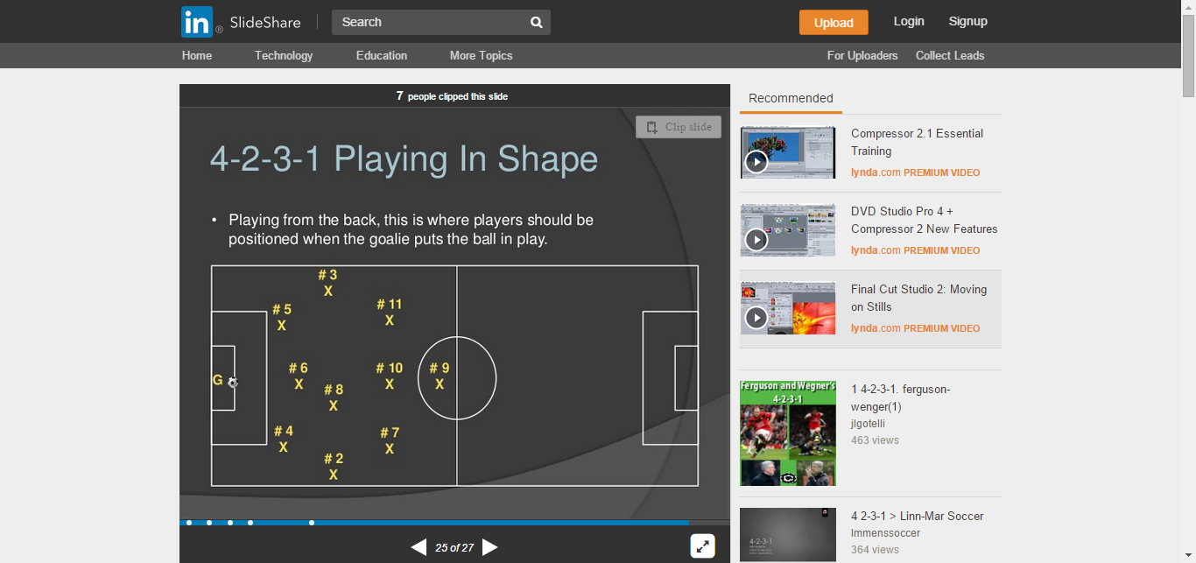
4.2.3.1
Playing in shape
Playing from the back,
Players positioned when the goalie puts the ball in play

Slide 26
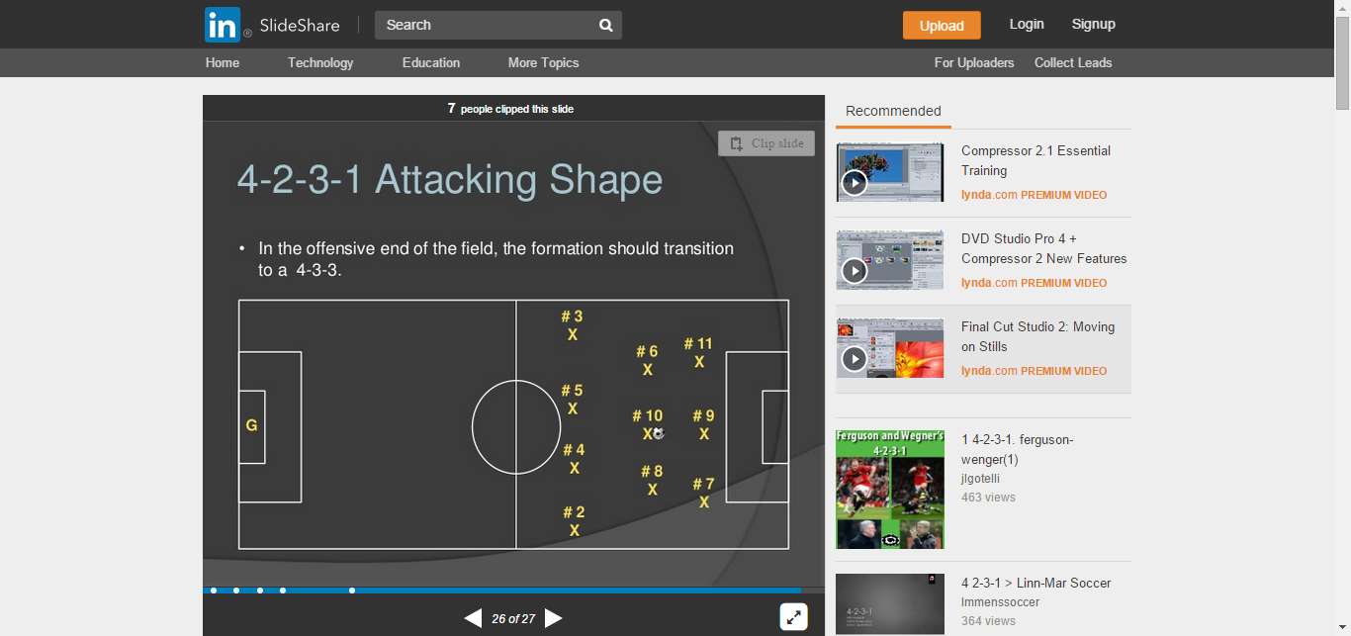
4.2.3.1
Attacking shape
The formation transition to a 4.3.3

Slide 27

4.2.3.1
Defending shape
The formation transitions
to a 4.4.1.1

Slide 28
Thank you

Slide 29
Pressing as a team in a
4.2.3.1
Anthony hudson

Slide 30
Moment we lose the ball….
Can we win it back immediately?
Yes or if no ….
Slow opposition attack down
Get into our defensive shape

Slide 31
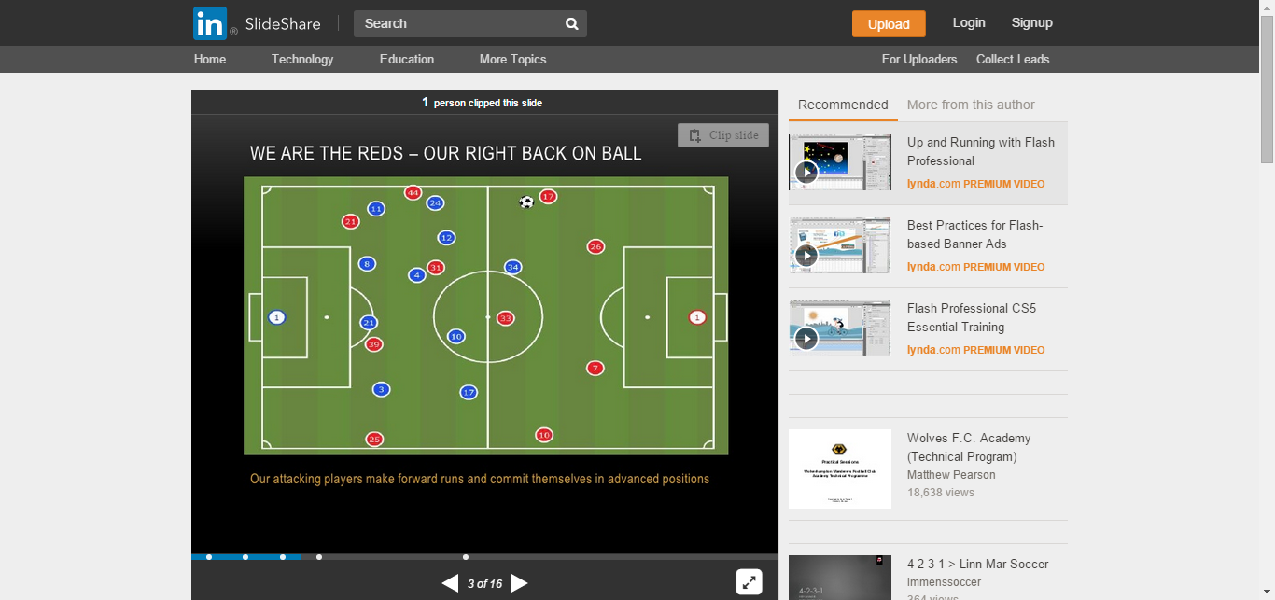
We are the reds –
our right back on ball
Our attacking players
make forward runs and commit themselves in advance position

Slide 32
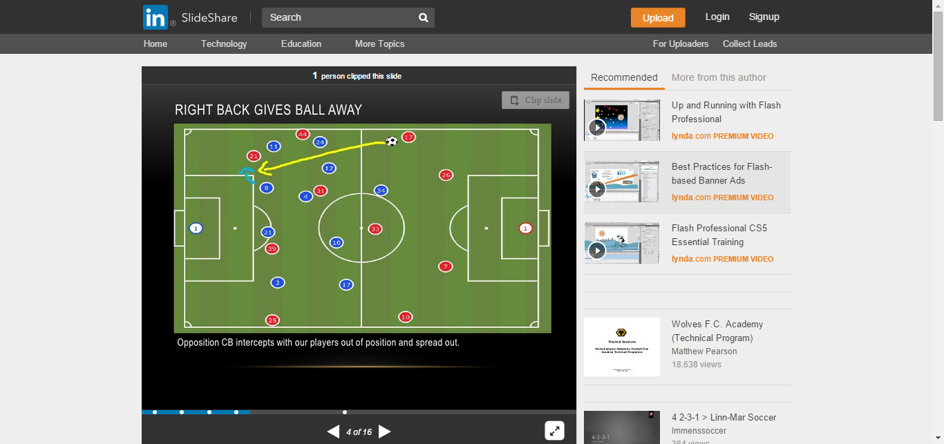
Right back gives ball away
Opposition CB intercepts with our players out of position and spread out

Slide 33
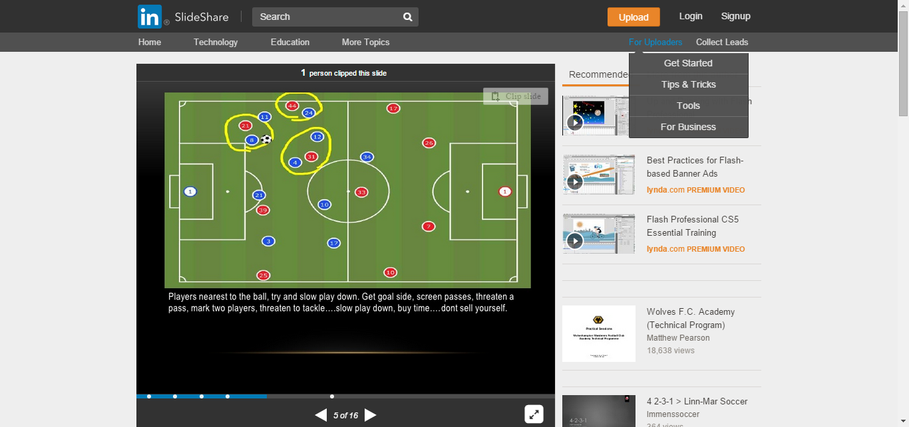
Players nearest to the ball try and slow play down.
Get goal side,
screen passes, threaten a pass,
mark two players, threaten to tackle…
Slow play down,
buy time…..don’t sell yourself.

Slide 34
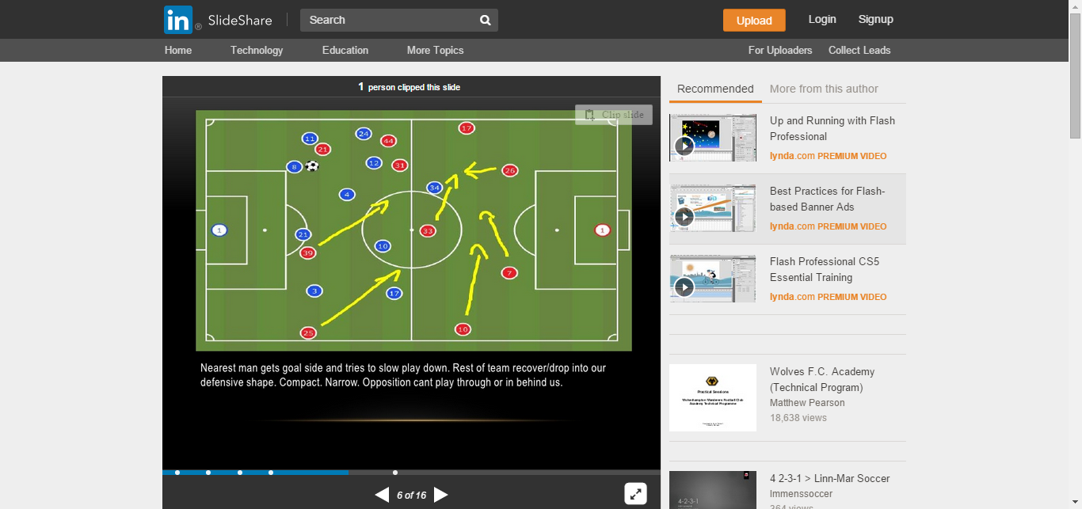
Nearest man gets goal side and tries to slow play down.
Rest of team recover/drop into our defensive shape.
Compact.
Narrow.
Opposition can`t play through or in behind us.

Slide 35
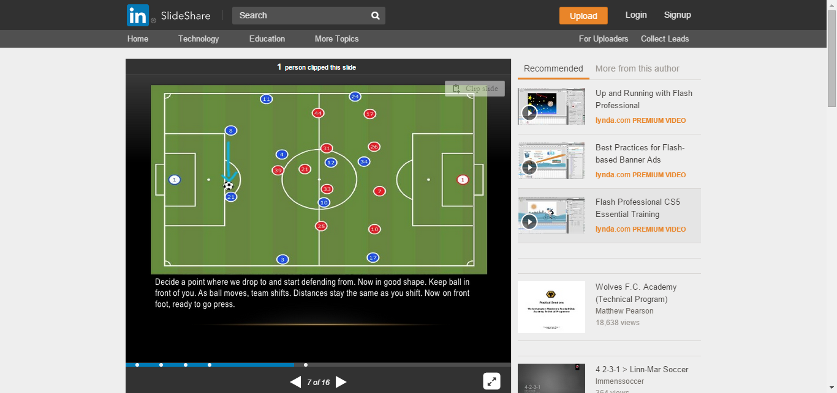
Decide a point where we drop to and start defending from.
Now in good shape. Keep ball in front of you.
As ball moves, tea shifts.
Distances stay the same as you shift.
Now on front foot, ready to go press.

Slide 36
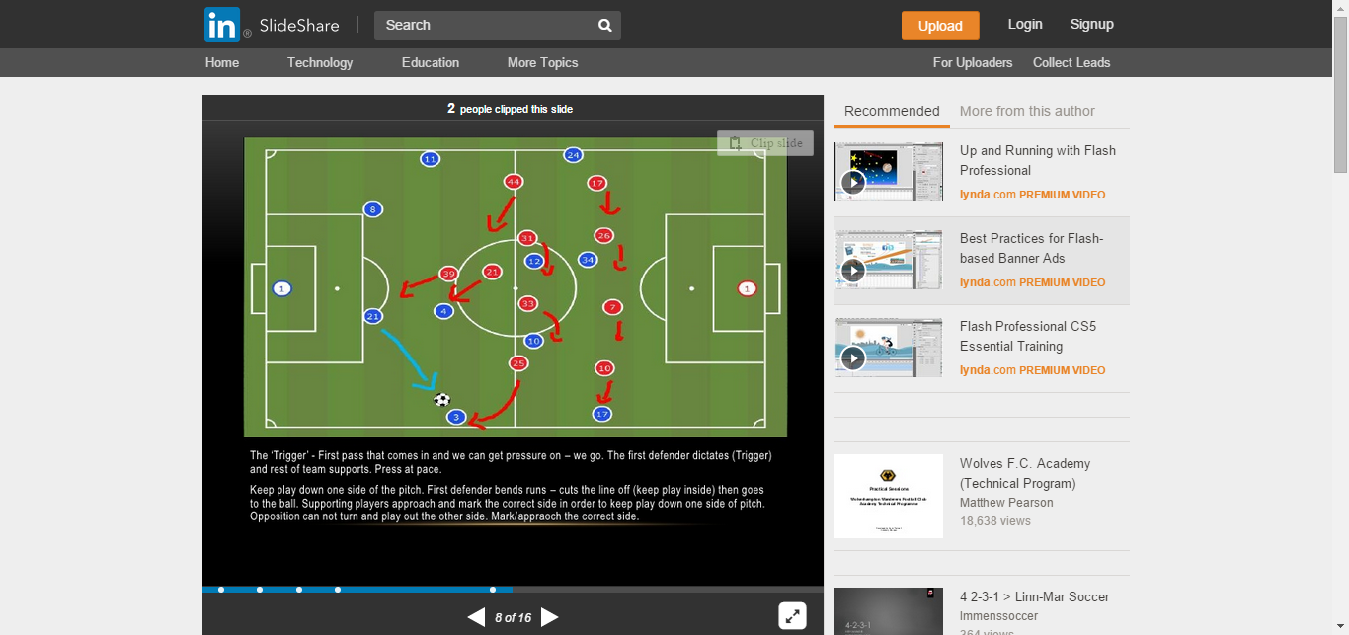
The `trigger`- the first defender dictates (trigger) and rest of team supports.
Press at pace.
Keep play down one side of the pitch.
First defender bends runs – cuts the line off (keep play inside) then goes to the ball.
Supporting players approach and mark the correct side.
Opposition can not turn and play out the other side.
Mark/approach the correct side.

Slide 37
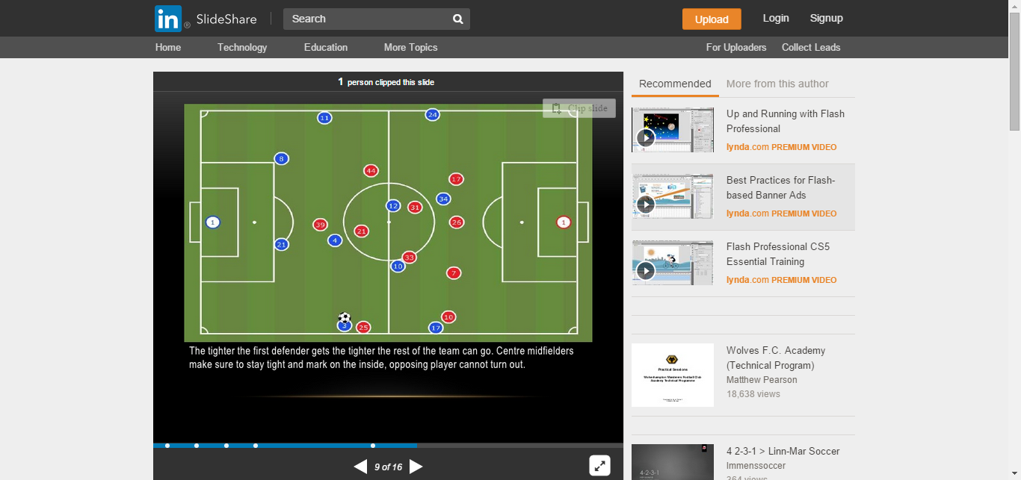
The tighter the first defender gets the tighter the rest of the team can go.
Center midfielders make sure to stay tight and mark on the inside,
Opposition player can not turn out.

Slide 38
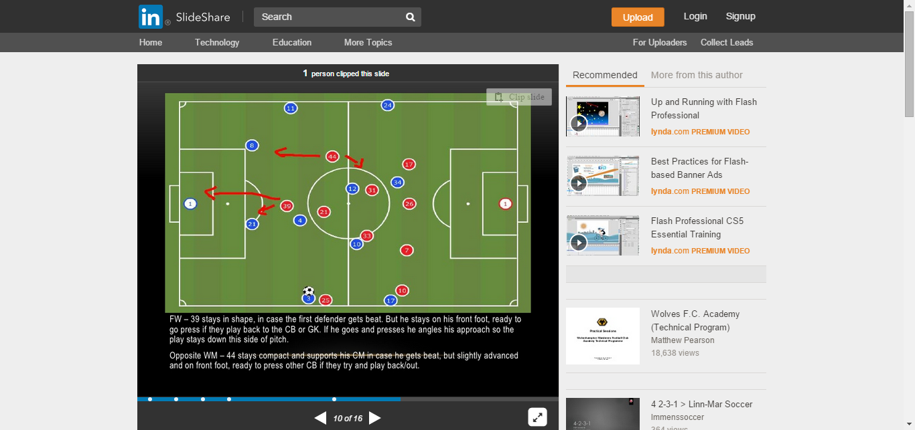
FW – 39 stay in shape, in case the first defender gets beat.
But he stay on his front foot, ready to go press if they play back to the CB or GK.
If he goes and presses he angles his approach so the play stay down this side of pitch.
Opposite WM – 44 stay compact and supports his CM in case he gets beat.
But slightly advanced and on front foot, ready to press other CB if they try and play back/out

Slide 39
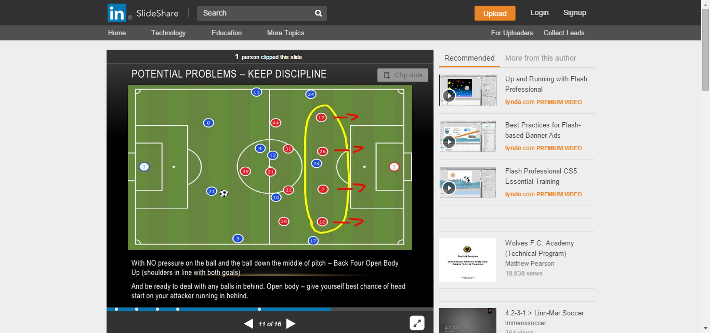
Potential problems –
keep discipline
With NO pressure on the ball and the ball down the middle of pitch – Back four open body
Up (shoulders in line with both goals).
And be ready to deal with any balls in behind.
Open body – give yourself best chance of head start on your attacker running in behind.

Slide 40
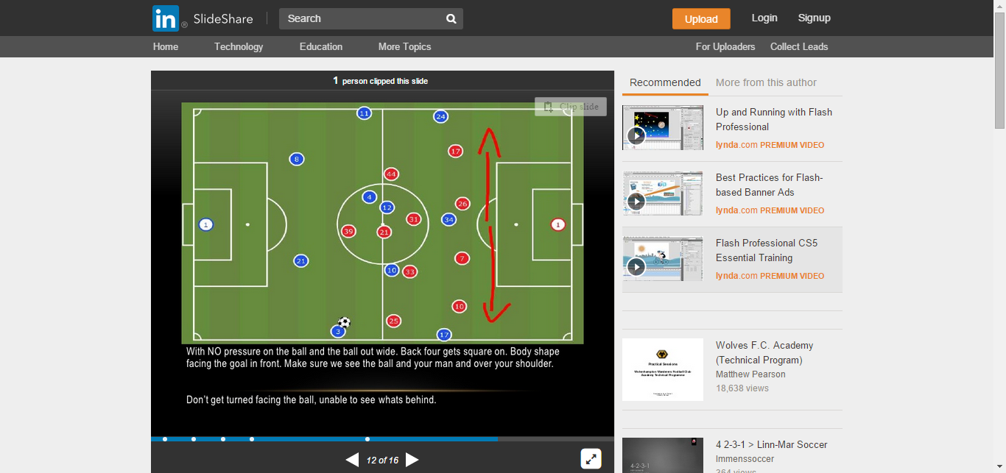
With NO pressure on the ball and the ball out wide.
Back four gets square on body shape facing the goal in front.
Make sure we see the ball and your man and over your shoulder.
Don`t get turned facing the ball, unable to see what is behind

Slide 41

With NO pressure on the ball and on chance of getting pressure on the man AS THE BALL GETS THERE, players must stay and keep there shape.
All that happens is they now just play round and expose the space just opened up.

Slide 42
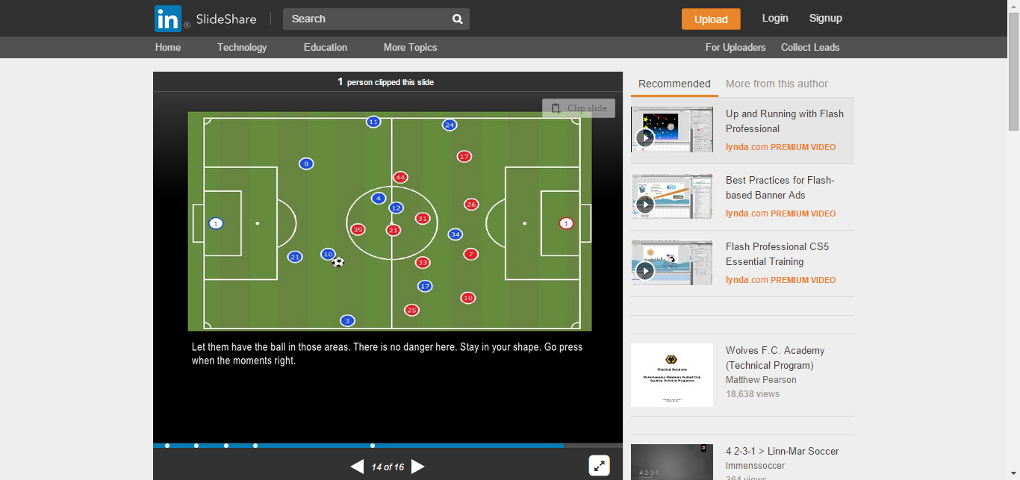
Let them have the ball in those areas.
There is no danger here.
Stay in your shape.
Go press when the moments right

Slide 43
Key points….
The nearest man slows play down (go to ball and or screen forward pass)
Defenders delay the play / buy time
Team mates drop into defensive shape as quickly as possible
Team stay compact and keep the ball in front of them
Once in good defensive shape the team now looks for the right moment to press – look for the trigger.

Slide 44
What effects how we defend?
State of the game, 1- 0 down/up – man up, man down
Characteristics of players
(pace/size of defenders, pace of attackers, ….. etc)
Mentality of players and culture of country/club
Playing home or away / 1 or 2 legs
The weather (temperature)

Slide 45
Thank you

